Slide 1
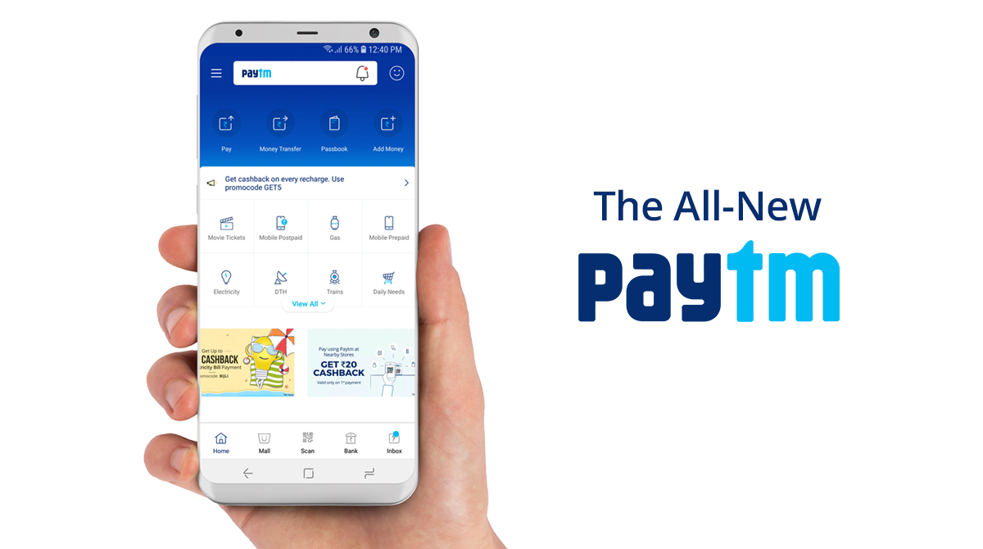
Project Name: Paytm «Paytm Karo»
Abstract : A study about Paytm a successful Fintech in India expanding exponentially with its smart features and a unique marketing model.
Project by :- Vickysingh Baghel & Manasa Shankara Murthy
Professor :- Stefano Bonini
Subject :- Fintech

Slide 2

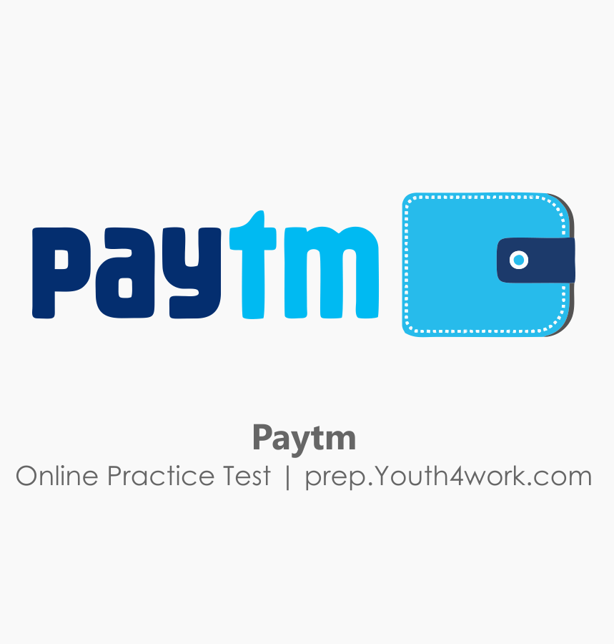
INTRODUCTION TO PAYTM
Paytm short for ‘Pay Through Mobile’ is an Indian electronic payment and e-commerce brand based out of Delhi.
Launched in 2010 by One97Communication Ltd by Vijay Shekar Sharma with an investment of 2 million dollars.
Initially Paytm started off as a prepaid mobile and DTH recharge platform, and later added data card, post-paid mobile and landline bill payments in 2013.
Currently Paytm has expanded as online payment platform including mobile recharges, utility bill payment, and various wallet payments.

Slide 3

“Paytm Karo”
The major investors in Paytm include:
Ant financial known as Alipay,
Alibaba groups,
Tata groups,
SAIF partners,
Silicon Valley Bank and
Sapphire venture (Bailey & Chakravarty 2015).

Slide 4
REVENUE MODEL OF PAYTM
Advertising Revenue Model: In this model Paytm allows sellers to show their advertisements on Paytm websites and charges some amount for their advertisement..
Subscription Model: In this, Paytm allows different sellers to list their products on their websites and charges some annual subscription fees from the seller which generates revenue.
Advance Payment Model: In this model, Paytm receives the interest on the payment of the customer until they do not transfer the money in the seller account.
Interest (ranging 4-6%) received from escrow account maintained in a nationalized bank,
Commission Revenue Model: Through this model, Paytm charges commission from the seller for their listed product in Paytm websites
Commission from utility payments and recharges,
Commission of 2% for transferring money from merchant e-wallets to their bank accounts.
Commission of 2% adding money from Credit card to e-wallets.
Commission of 4% transferring money from Credit card to Bank accounts
Paytm has reported a 10 percent year-on-year growth in revenue to Rs 3,629crore (510 million USD) in financial year (FY) 2020

Slide 5
MARKETING STRATEGY OF PAYTM
The marketing mix of Paytm covers the 7Ps of marketing:
Product
Price
Place
Promotion
People
Process
Physical Evidence
The marketing model of Paytm during the Demonetisation in India
Twitter campaigns assuring a fitting solution to the cash crunch problem
Aggressive advertising across print media
Addressing day-to-day problems faced during the cash crisis
The QR Code Scanner facility at the bottom of the pyramid
Tie-ups with big names eg Mcd, Dominos
Choice of media
Enormous advertising budget

Slide 6
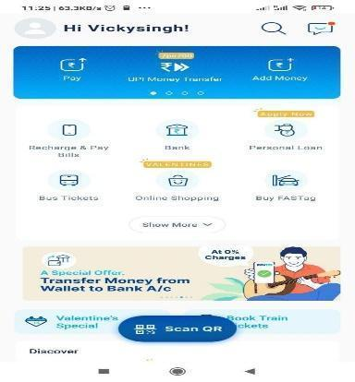
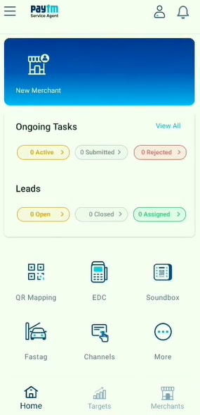
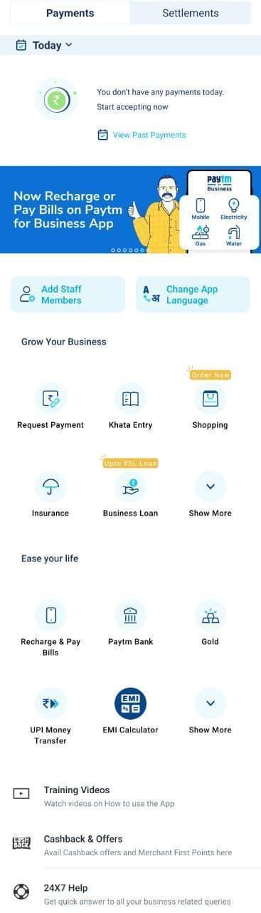
PAYTM DASHBOARDS
Paytm Dashboard for customers:
Paytm Dashboard for Business:
Paytm Dashboard for Agent:

Slide 7

PAYTM CUSTOMER FEATURES
Mobile Recharge and Bill Payments
You can invest in Stock Market and Digital Gold
To Books Movie and Travel Tickets
Fund Transfers to your bank account
Paytm bank offer you debit card and credit card
Online shopping with nearest stores by simply using QR code
Insurance (All Types of Insurance)
Paytm chat (for chatting with people)
FasTag for Toll Tax payment
Personal Loan by calculating the credit score

Slide 8
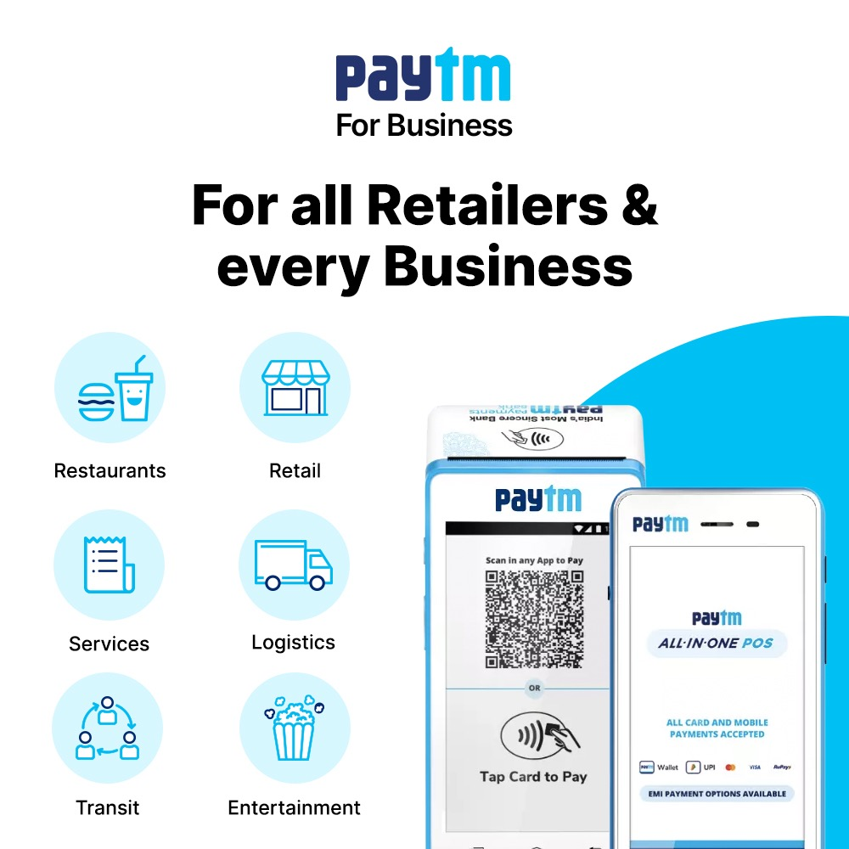
PAYTM MERCHANTS (PAYTM FOR BUSINESS) FEATURES :
Payments Tab: Using the payments tab feature, you can easily track payments received and even download statements.
Settlements: Instant Settlement feature allows you to manually transfer money to your bank accounts at any point of time.
Request Payment: Request payment with payment link to Customer
Khata Entry (Ledger): Manage books by helping them track the money owed to them through the means of digital Ledger..
Khata Report: You can view the pending payment and received payment of all customers in one report daily, monthly, quarterly and yearly basis.
GST Invoice: You can see all Tax Invoice

Slide 9


PAYTM SERVICE AGENT IN PAYTM CAN EARN A REVENUE:
Paytm provides an earning opportunity by creating a Service agent, the agent will have an option of: On-boarding shopkeepers for Paytm by placing a QR code at their shop.
Paytm agent generate commission by adding new merchant
Sell Paytm QR Sound Box
Sell Paytm EDC Card Machine
Bus Ticket Booking: 5%
Utility Bill Payment: 1%
Flight Booking: 2%*
Recharge: 0.20%
Movies & Event Booking: 2%*
Hotel Booking commission
New UPI User – Rs.10 Per User

Slide 10
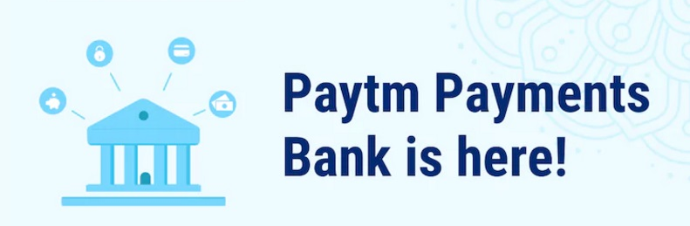
Paytm Payments Bank
Its will be a fully fledged payment bank just like (SBI,HDFC,Kotak) but with a twist.
Paytm Bank Business Model is entirely be depended on the mobile apps. It is a Digital Bank
For Those how do not have smart phone, Paytm issue Debit card
Banks can accept deposits of up to 1 lakh from each individual customer.
Services such as ATM cards, net banking non-risk financial products such as mutual fund and insurance.

Slide 11
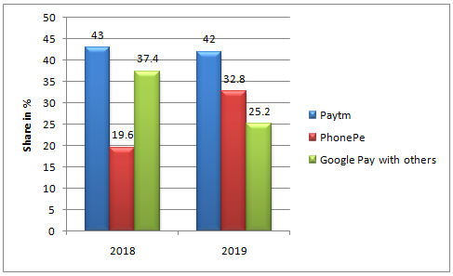
Competitors of Paytm
Freecharge
Mobikwik
Google pay
Amazon pay
PhonePe
Airtel Bank
Jio Money
Ola Money
RazorPay
MiPay
Samsung Pay
Apple Pay
Bhim UPI
PayPal
AliPay

Slide 12
SWOT ANALYSIS OF PAYTM
Strength
First mover advantage
Convenience Option
Tie up with merchants
Services and Offers
Weakness
Need for IT
Lack of awareness
Fear of going cashless
Poor customer service
Opportunities
Growing demand for aggregators
Demonetisation
Increase in working professionals
Threats
Competition
Growing concern about safety

Slide 13
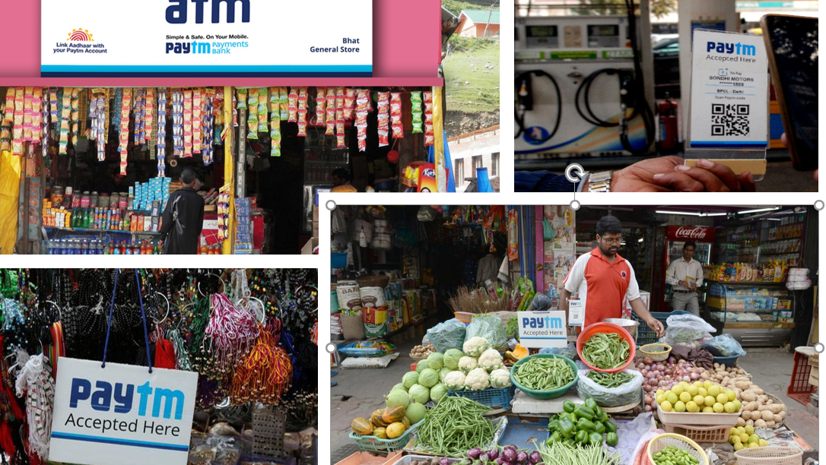
CONCLUSION
Paytm has been ranked the 5th best fintech company globally in the payment’s category with 100 million digital wallet users.
Paytm is India’s fastest growing Fintech Industry
Paytm has an opportunity to capture maximum population
Paytm has launched AI cloud for India
Paytm has also started the global market. Paytm has just launched it’s service in Canada.
Paytm in last round of fundraising has been valued at about USD 16 billion.

Slide 14
THANK YOU Q&A

